Slide 1


Recognizing Set of Human Activities from Video Dataset using Machine Learning
Carried Out By: Under the Guidance of:
Akash Hegde (1RN14IS010) Dr. M V Sudhamani
Akshay Sudhir Hulekal (1RN14IS013) Professor & HoD
Mithun Bharadwaj B V (1RN14IS059) Dept of ISE, RNSIT
Hitesh B Rao (1RN15IS406)

Slide 2
Agenda
Abstract
Introduction
Literature Review
System Specifications
System Architecture
Preliminary Design
Detailed Design
Implementation
Testing
Results
Conclusion
Limitations
Future Enhancements
References

Slide 3
Abstract
The problem of Human Activity Recognition is still largely unsolved.
Great results available for image related tasks, but not for video datasets.
KTH (Kungliga Tekniska Högskolan) dataset is suitable for video native tasks.
Methods to convert videos to frames.
Using suitable classifier for activity recognition, the results are compared and benchmarked.

Slide 4
Introduction
Machine Learning and Deep Learning techniques are used to better understand human activities.
Self-correcting Neural Networks are built to produce accurate results.
Dataset plays a vital role in predicting the classes.
Examples of human activity video datasets – Weizmann, Charades, UCF-Sports (University of California), HMDB51 (Human Motion Database).
KTH provides a dataset containing 600 videos, resulting on an average of 3 lakh frames.

Slide 5
Introduction
KTH dataset is used, along with TensorFlow, Keras and Python libraries.
Classifiers – CNN (Convolutional Neural Networks), LSTM (Long Short-Term Memory) and GRU (Gated Recurrent Units).
Comparison – LSTM vs. GRU.
Accuracy is compared with changing no. of epochs, training and test set parameters.
Confusion matrix.

Slide 6
Literature Review
Shikhar Shrestha (2016) – Charades dataset and fusion-based architecture based on CNNs (Convolutional Neural Networks) and RNNs (Recurrent Neural Networks).
Andrej Karpathy, et al. (2014) – Empirical evaluation of CNNs on large-scale YouTube video dataset.
Christian Schüldt, et al. (2004) – Human Activity Recognition on KTH dataset using STIPs (Spatio-Temporal Interest Points) with SVM (Support Vector Machine) approach.
Du Tran, et al. (2015) – Spatio-temporal feature learning using 3D Convolutional Networks.

Slide 7
Literature Review
Nitish Srivastava, et al. (2016) – Multi-layered LSTMs (Long Short-Term Memory) blocks to learn representations of video sequences.
Yang Qin, et al. (2016) – General feature combination method for 3D CNNs and LSTMs.
Andros Tjandra, et al. (2016) – Novel implementation of LSTM and GRU (Gated Recurrent Units) RNNs (Recurrent Neural Networks).
Xuanhan Wang, et al. (2016) – Integrating LSTM with salient-aware deep 3D CNN features on video shots.

Slide 8
System Specifications
HARDWARE USED |  | SOFTWARE USED
Processor | Quad-core 64-bit Core i3 | OS | Windows 7 Service Pack 1
Speed | 2 GHz | Front-end | Django 1.9 and supporting libraries
RAM | 4GB | Back-end | KTH Dataset, Keras 2 over TensorFlow and supporting libraries
Hard Disk | 500GB | Text editor | PyCharm Community Edition 2017
GPU | Intel HD | Others | Python 3.6, FFmpeg, OpenCV, Graphviz
HARDWARE REQUIREMENTS | SOFTWARE REQUIREMENTS

Slide 9
System Architecture
Input Layer
Convolution Layers
Activation Layers
Flattening Layer
Batch Normalization Layer
Activation Layer
LSTM or GRU Layer
Dropout Layer
Fully-connected Dense Layers

Slide 10
Preliminary Design
Accumulation of Dataset
Data Pre-Processing
Conversion of Videos to Frames
Building the Model
Training the Model
Testing the Model
Tabulation of Results, Comparison of Accuracies and Log Times

Slide 11
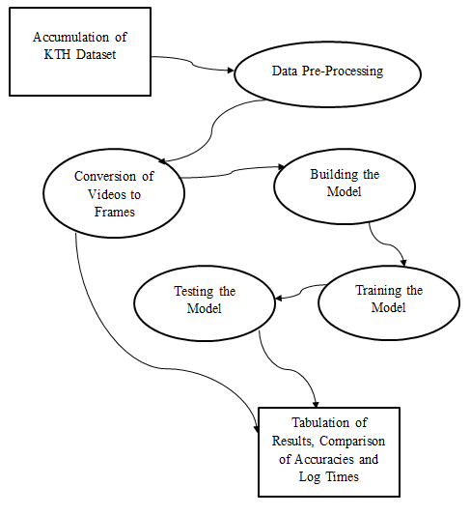
Detailed Design
Data Flow Diagram of the System :

Slide 12
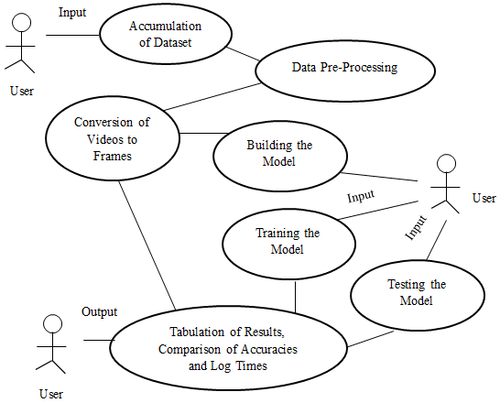
Detailed Design
Use Case Diagram of the System :

Slide 13
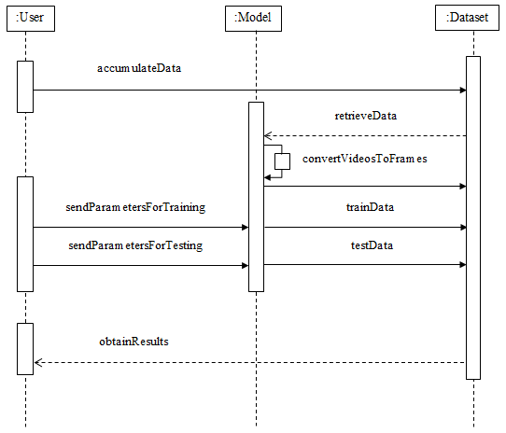
Detailed Design
Sequence Diagram of the System :

Slide 14
Implementation
Usability and Technical aspect.
KTH Dataset is open-source.
Sequential model techniques.
Installation of various technologies and software.
* Python * PyCharm * TensorFlow * Keras
* Numpy * FFmpeg * OpenCV * Matplotlib
* Graphviz * Pydot * h5py * Django

Slide 15
Dataset
KTH Dataset
Boxing
Hand
Clapping
Hand
Waving
Jogging
Running
Walking
100
Videos
100
Videos
100
Videos
100
Videos
100
Videos
100
Videos
100 Videos = 25 Persons * 4 Scenarios

Slide 16
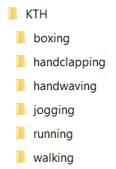
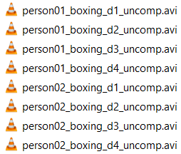
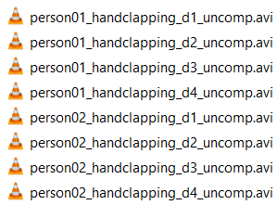
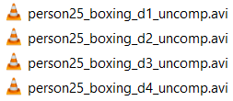
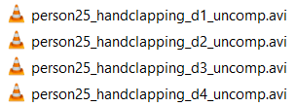
Main Directory Structure :
Boxing Sub-directory Structure :
Handclapping Sub-directory Structure :
…
…

Slide 17
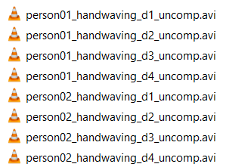
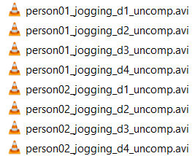
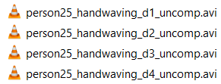
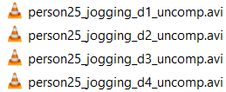
Handwaving Sub-directory Structure :
Jogging Sub-directory Structure :
…
…

Slide 18
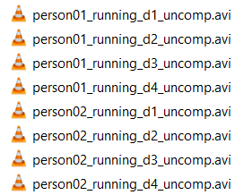
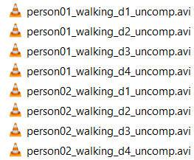
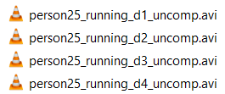
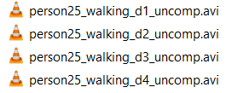
Running Sub-directory Structure :
Walking Sub-directory Structure :
…
…

Slide 19
Code to Convert Videos to Frames using FFmpeg
log the start time
for x from 0 to number of class labels:
specify class folder paths
create folders and subfolders using mkdir
open indices file in read mode
for j from 1 to number of persons:
read each line from indices file
for k from 1 to number of scenarios:
make folder to store frames
if line in file matches subfolder name:
convert video to frames using ffmpeg command
make segments
for p from 0 to number of segments:
create segment folders
for q between range of segment frames:
move frames to segments
else:
print “Invalid index”
close indices file
log the finish time

Slide 20
Code to Convert Videos to Frames using OpenCV
log the start time
for x from 0 to number of class labels:
specify class folder paths
create folders and subfolders using mkdir
open indices file in read mode
for j from 1 to number of persons:
read each line from indices file
for k from 1 to number of scenarios:
make folder to store frames
if line in file matches subfolder name:
capture the video file
count number of frames
convert video to frames using cv2 cap methods
make segments
for p from 0 to number of segments:
create segment folders
for q between range of segment frames:
move frames to segments
else:
print “Invalid index”
close indices file
log the finish time

Slide 21
Trial No. | FFmpeg Log Time (in seconds) | OpenCV Log Time (in seconds)
1 | 1695.91 | 1985.83
2 | 1535.98 | 2200.98
3 | 1700.03 | 1998.87
4 | 1677.23 | 2001.22
5 | 1630.09 | 2056.76
6 | 1580.75 | 2026.11
7 | 1712.26 | 1990.54
Log Times of FFmpeg vs. OpenCV

Slide 22
Code to Load Data (person by person)
for i from 0 to number of class labels:
specify class folder
for j from start person index to finish person index:
for k from 1 to number of scenarios:
specify recording folder
for m from 1 to number of segments:
specify segment folder
get list of files
sample the frames
create list for each segment
pre-processing methods
create one-hot encoded vectors
make numpy array for particular person data
return numpy array and one-hot vector

Slide 23
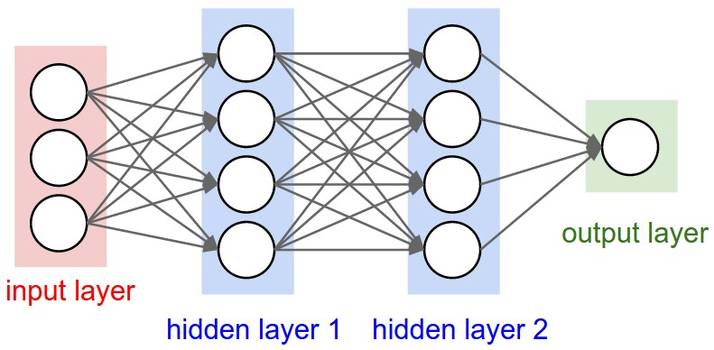
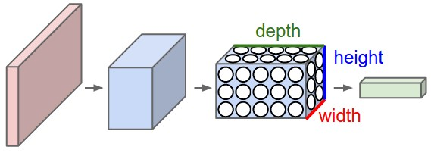
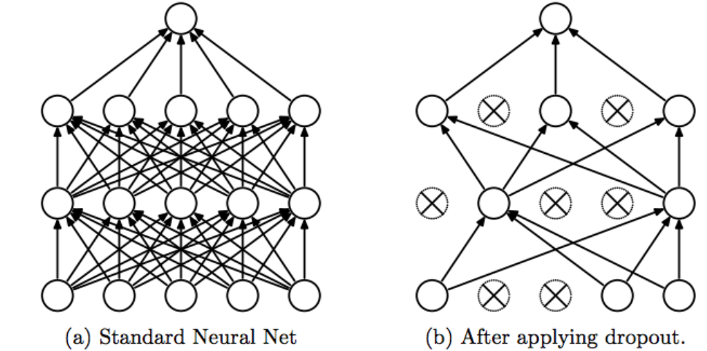

Slide 24
Code to Build the Model
number of rows in image = 120
number of columns in image = 160
number of classes = 6
log the start time
specify sequential model being used
add first convolution layer with input shape of rows and columns
add its activation function
add two more convolution layers and their activation functions
flatten the input and prepare for recurrent learning
add a single dense layer
batch normalization of layers
add LSTM/GRU layer
add a small dropout
add two fully-connected dense layers
compile with loss function and optimizer
print model summary
plot model to an image file
log the end time

Slide 25
Code to Train and Test the Model
batch size = 64
number of epochs = 30
log the start load time
load data for persons within given training range
log the end load time
log the start train time
train using model.fit()
clean up the memory, for testing
log the end train time
log the start test time
load data for persons within given testing range
get predictions using model.predict()
calculate accuracy
plot confusion matrix
log the end test time
output log times, accuracy and confusion matrix
save confusion matrix in an image file
save model parameters in a JSON string
save model architecture and weights in a HDF5 file

Slide 26
Code to Display Front-End Views
import render and HTTP libraries
define start page:
provide link to next HTML page
define page2:
display information
provide link to next HTML page
define page3:
display information
provide link to next HTML page
define input page:
take training, testing parameters, number of epochs as input
pass these values to a text file
provide link to output HTML page
define writing to file:
open text file in write mode
write parameters line by line
call main program script using system call
return parameters to output page

Slide 27
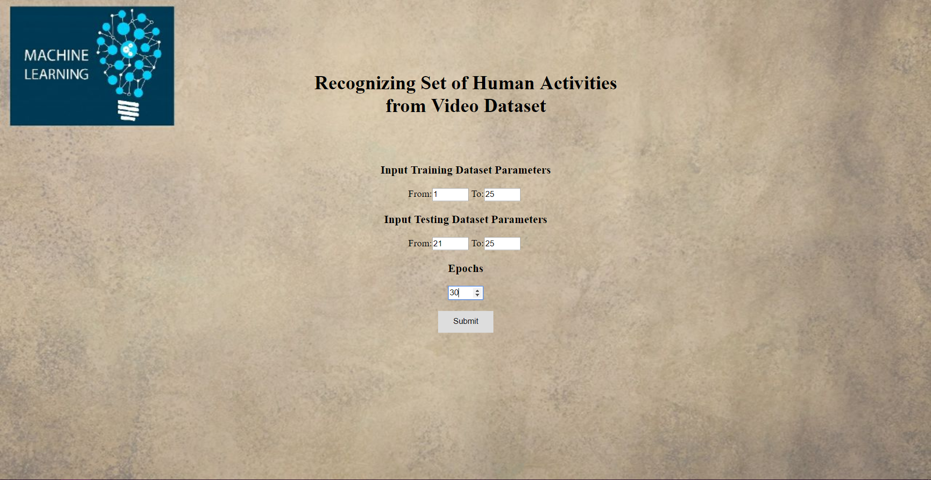
Front-End Designed to Receive User Input

Slide 28
Testing
Unit Testing – User Input and Error Handling.
Integration Testing for modules.
System Testing on various parameters.
Validation Testing.
User Acceptance Testing for input parameters.
Training and Testing data split as 80:20 in terms of person numbers, for each activity in the dataset.

Slide 29
Results
Trial No. | Epochs | Train Set (Person Indexes) | Test Set (Person Indexes) | Test Samples | Load Data Time of LSTM (in seconds) | Load Data Time of GRU (in seconds)
1 | 30 | 1 - 10 | 4 – 4 | 96 | 99.19 | 103.18
2 | 30 | 1 - 10 | 4 – 6 | 288 | 98.95 | 98.49
3 | 30 | 1 - 20 | 21 – 25 | 480 | 393.63 | 365.53
4 | 30 | 1 - 25 | 21 – 25 | 480 | 561.43 | 563.02
5 | 50 | 1 - 20 | 21 – 25 | 480 | 365.82 | 365.72
6 | 100 | 1 - 20 | 21 – 25 | 480 | 368.35 | 361.44
7 | 200 | 1 - 20 | 21 – 25 | 480 | 365.47 | 364.67
8 | 100 | 1 - 20 | 19 – 25 | 672 | 365.85 | 362.84
9 | 100 | 1 - 20 | 15 – 25 | 1056 | 365.36 | 365.09
Comparison of Load Data Times of LSTM and GRU

Slide 30
Results
Trial No. | Epochs | Train Set (Person Indexes) | Test Set (Person Indexes) | Test Samples | Training Time of LSTM (in seconds) | Training Time of GRU (in seconds)
1 | 30 | 1 - 10 | 4 – 4 | 96 | 62.27 | 61.39
2 | 30 | 1 - 10 | 4 – 6 | 288 | 62.65 | 61.83
3 | 30 | 1 - 20 | 21 – 25 | 480 | 122.59 | 121.36
4 | 30 | 1 - 25 | 21 – 25 | 480 | 153.33 | 151.32
5 | 50 | 1 - 20 | 21 – 25 | 480 | 202.81 | 201.16
6 | 100 | 1 - 20 | 21 – 25 | 480 | 402.55 | 399.61
7 | 200 | 1 - 20 | 21 – 25 | 480 | 809.72 | 796.59
8 | 100 | 1 - 20 | 19 – 25 | 672 | 406.84 | 397.71
9 | 100 | 1 - 20 | 15 – 25 | 1056 | 406.46 | 398.72
Comparison of Training Times of LSTM and GRU

Slide 31
Results
Trial No. | Epochs | Train Set (Person Indexes) | Test Set (Person Indexes) | Test Samples | Testing Time of LSTM (in seconds) | Testing Time of GRU (in seconds)
1 | 30 | 1 - 10 | 4 – 4 | 96 | 2.57 | 2.61
2 | 30 | 1 - 10 | 4 – 6 | 288 | 12.33 | 12.31
3 | 30 | 1 - 20 | 21 – 25 | 480 | 43.87 | 28.93
4 | 30 | 1 - 25 | 21 – 25 | 480 | 28.96 | 28.67
5 | 50 | 1 - 20 | 21 – 25 | 480 | 28.69 | 28.75
6 | 100 | 1 - 20 | 21 – 25 | 480 | 28.89 | 28.45
7 | 200 | 1 - 20 | 21 – 25 | 480 | 28.83 | 29.26
8 | 100 | 1 - 20 | 19 – 25 | 672 | 52.21 | 52.27
9 | 100 | 1 - 20 | 15 – 25 | 1056 | 118.42 | 118.75
Comparison of Testing Times of LSTM and GRU

Slide 32
Results
Trial No. | Epochs | Train Set (Person Indexes) | Test Set (Person Indexes) | Test Samples | Accuracy of LSTM (in %) | Accuracy of GRU (in %)
1 | 30 | 1 - 10 | 4 – 4 | 96 | 93.75 | 96.88
2 | 30 | 1 - 10 | 4 – 6 | 288 | 82.29 | 90.625
3 | 30 | 1 - 20 | 21 – 25 | 480 | 43.75 | 47.5
4 | 30 | 1 - 25 | 21 – 25 | 480 | 98.125 | 93.75
5 | 50 | 1 - 20 | 21 – 25 | 480 | 50.625 | 43.54
6 | 100 | 1 - 20 | 21 – 25 | 480 | 53.75 | 50.21
7 | 200 | 1 - 20 | 21 – 25 | 480 | 48.96 | 50.625
8 | 100 | 1 - 20 | 19 – 25 | 672 | 63.98 | 60.71
9 | 100 | 1 - 20 | 15 – 25 | 1056 | 78.5 | 75.85
Comparison of Accuracies of LSTM and GRU

Slide 33
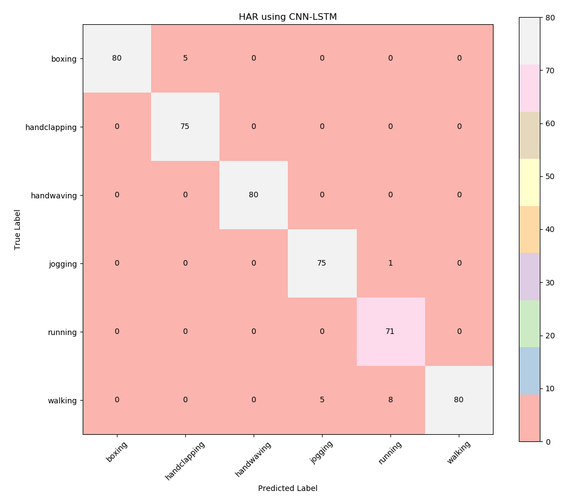
Results
Sample Confusion Matrix Output for CNN-LSTM Combination

Slide 34
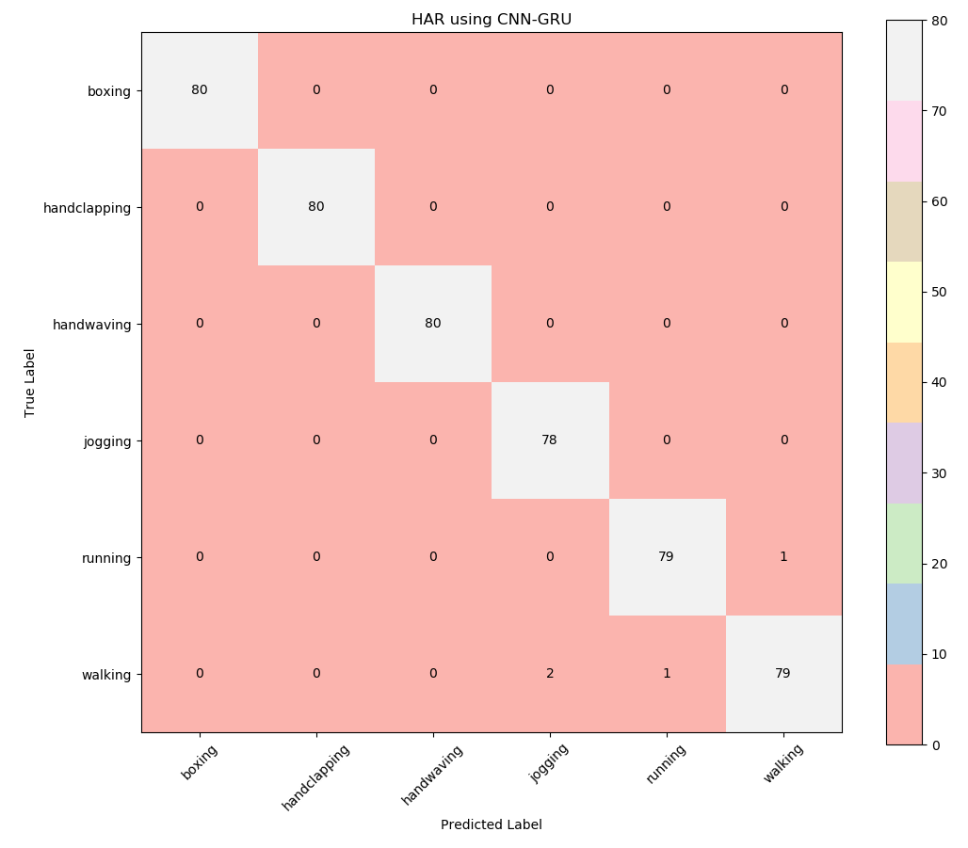
Results
Sample Confusion Matrix Output for CNN-GRU Combination

Slide 35
Conclusion
Human Activity Recognition one of the most important problems in recent times.
Recognition of six day-to-day human activities using a sequential model, based on multi-layered architecture.
Conversion of videos to frames - FFmpeg performed better than OpenCV.
Classification of class labels - LSTM preferred over GRU for entire dataset.
GRU suitable for smaller datasets.

Slide 36
Limitations
CNN works well only for medium to large datasets (at least 500 videos, in terms of number).
High computational cost, in terms of resource usage and disk space to accommodate datasets.
KTH Dataset consists of only grey-scale videos – absence of RGB channels.
Position and orientation of the object present in the frames is not encoded into the predictions.

Slide 37
Future Enhancements
Complex architectures to enhance accuracy.
Upgrading the system to deal with RGB datasets.
Combination of two or more techniques on a larger scale.
Embedding in CCTVs for industry purposes, detection and recognition of crime.

Slide 38
References
[1] | Shikhar Shrestha, “Machine Learning for Human Activity Recognition from Video”, Stanford University, CA, 2016.
[2] | Andrej Karpathy, George Toderici, Sanketh Shetty, Thomas Leung, Rahul Sukthankar and Li Fei-Fei, “Large-scale Video Classiﬁcation with Convolutional Neural Networks”, Google Research, Stanford University, CA, 2014.
[3] | Christian Schüldt, Ivan Laptev and Barbara Caputo, “Recognizing Human Actions: A Local SVM Approach”, Computational Vision and Active Perception Laboratory (CVAP) Dept. of Numerical Analysis and Computer Science, KTH, SE-100 44 Stockholm, Sweden, 2004.
[4] | Du Tran, Lubomir Bourdev, Rob Fergus, Lorenzo Torresani and Manohar Paluri, “Learning Spatio-temporal Features with 3D Convolutional Networks”, IEEE, 2015.

Slide 39
References
[5] | Nitish Srivastava, Elman Mansimov and Ruslan Salakhutdinov, “Unsupervised Learning of Video Representations using LSTMs”, University of Toronto, 2016.
[6] | Yang Qin, Lingfei Mo, Jing Ye and Zhening Du, “Multi-channel Features Fitted 3D CNNs and LSTMs for Human Activity Recognition”, Tenth International Conference on Sensing Technology, 2016.
[7] | Andros Tjandra, Sakriani Sakti, Ruli Manurung, Mirna Adriani and Satoshi Nakamura, “Gated Recurrent Neural Tensor Network”, IEEE, 2016.
[8] | Xuanhan Wang, Lianli Gao, Jingkuan Song and Hengtao Shen, “Beyond Frame-level CNN: Saliency-aware 3D CNN with LSTM for Video Action Recognition”, IEEE, 2016.

Slide 40
THANK YOU

